Slide 1
Detailed Analysis of IPL DataSet
Factors Affecting the victory of the team.

Slide 2
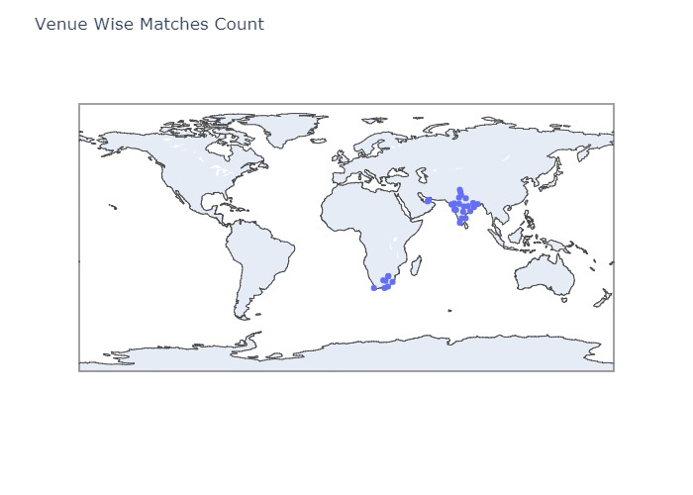
Distribution of Cricket Stadiums.

Slide 3
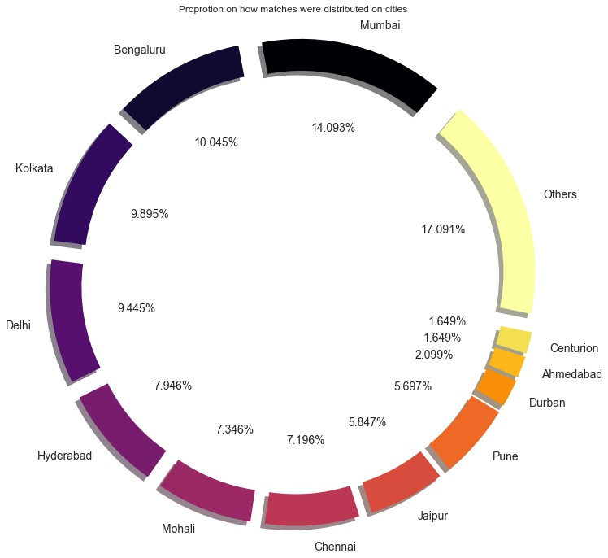
Where are the stadiums located?
It can be well noted that the ipl matches take place around the country as well as some parts of The UAE and South Africa.
It can also be noted that Mumbai has hosted the maximum number of matches. This was so maybe as it has 3 cricket stadiums
Apart from Mumbai, Bangalore and Kolkata have been popular cities to host the ipl matches

Slide 4
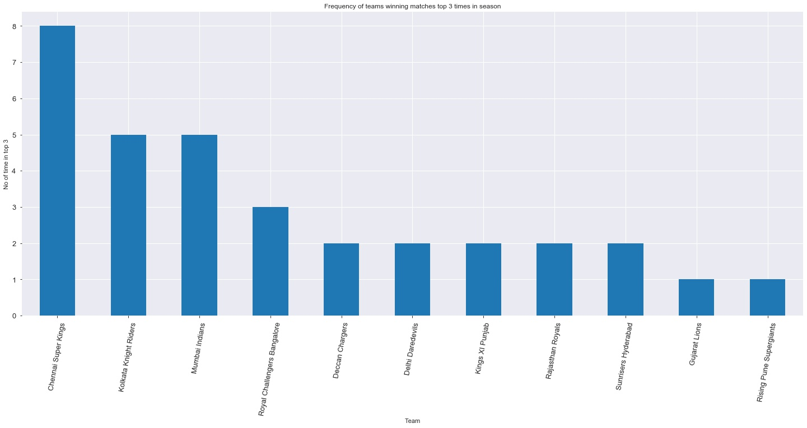
Top Performers

Slide 5
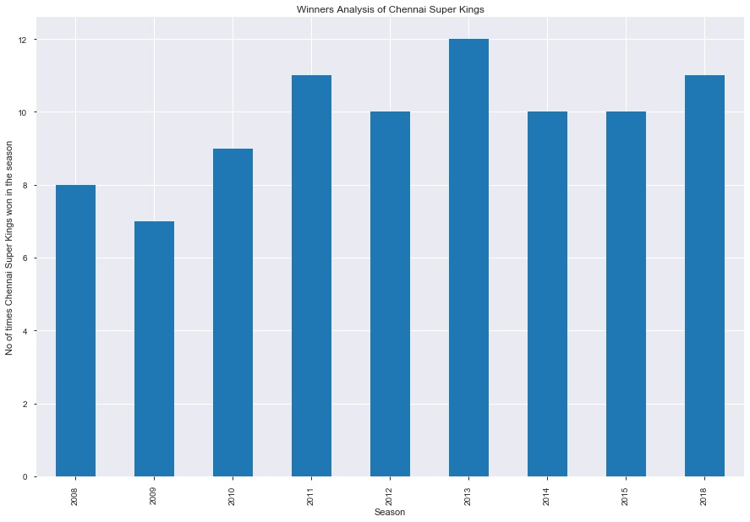


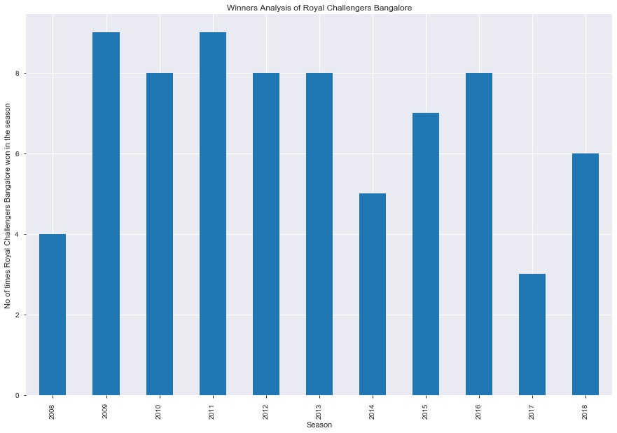
Analysis of the top performers per season

Slide 6
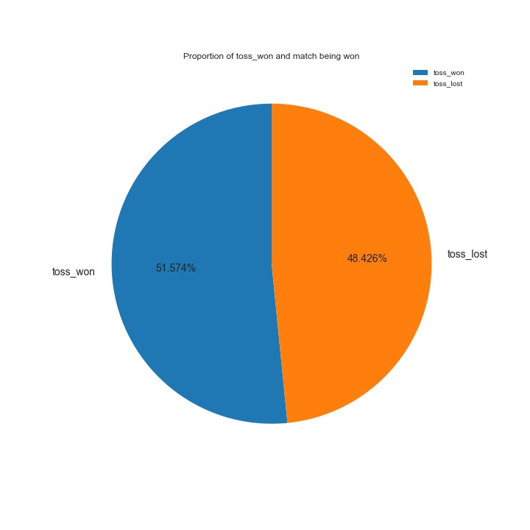
Does winning the toss matter?
Yes, According to the data 51.574% times the team that won the toss won the match.

Slide 7
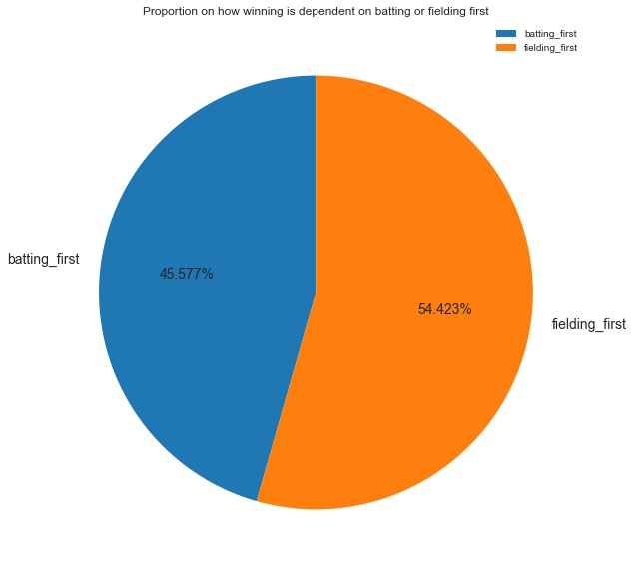
Batting or Fielding which to do first?

Slide 8
Team Wise Analysis Of What They Do Better?
Fielding Or Batting

Slide 9
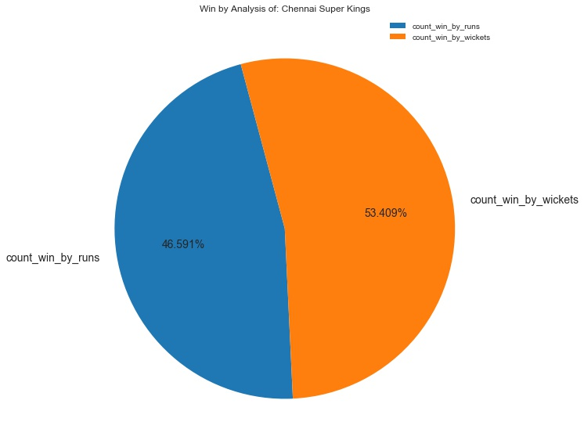
Chennai Super Kings
They are better at setting the target

Slide 10
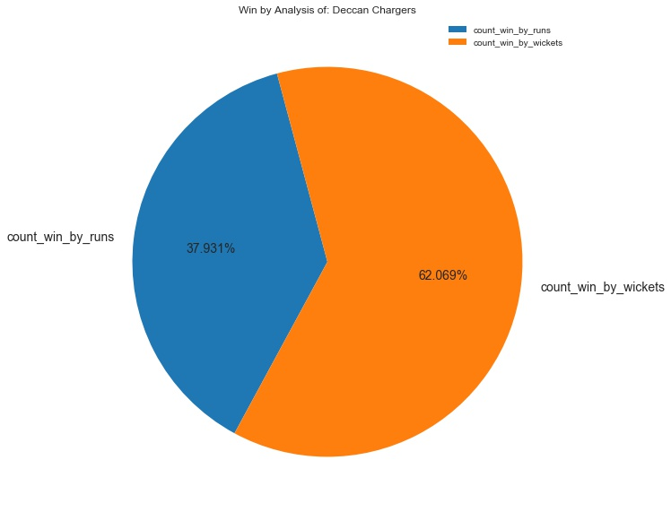
Deccan Charges
Let these guys chase.
They are pretty good at it.

Slide 11
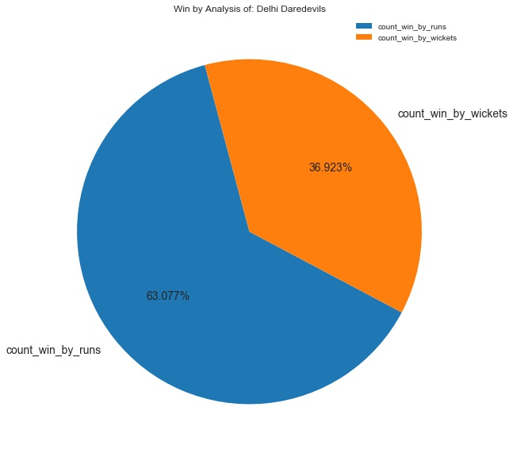
Delhi DareDevils
They are better at setting the target

Slide 12
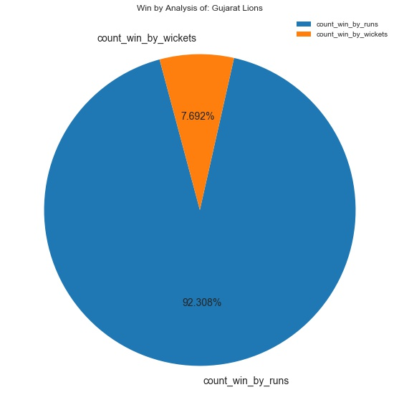
Gujrat Lions
Honestly, lions don’t chase that well.

Slide 13
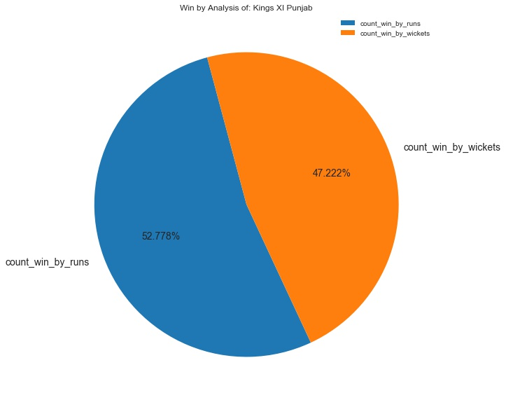
Kings XI Punjab
The Kings are good at setting target.

Slide 14
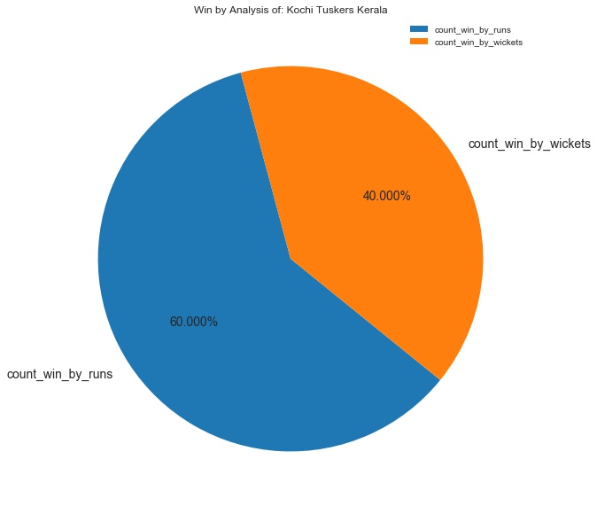
Kochi Tuksers
Win the toss, opt to bat!!!

Slide 15
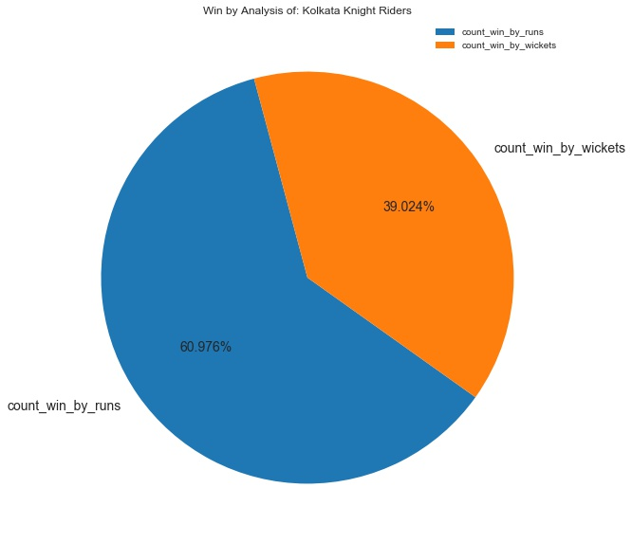
Kolkata Knight Riders
Are great on setting targets

Slide 16

Mumbai Indians
Can chase set targets!!!

Slide 17
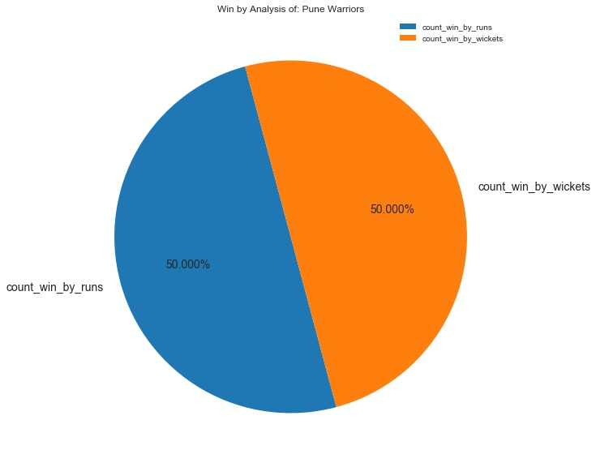
Pune Warriors
All Rounders!!!

Slide 18

Rajasthan Royals
They Command the batting

Slide 19
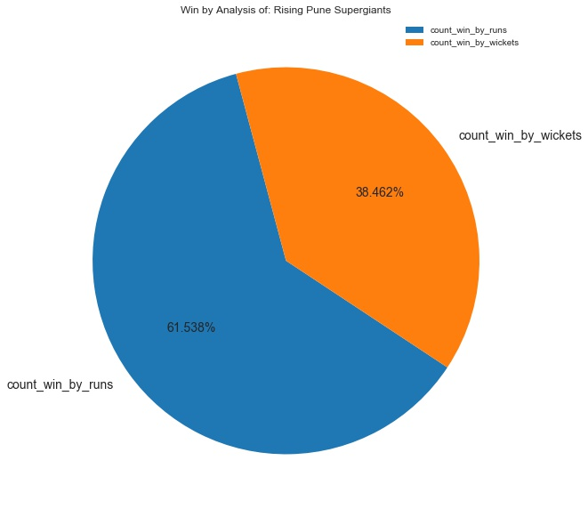
Rising Pune Supergiants
They are rising the power of the bat!!!

Slide 20
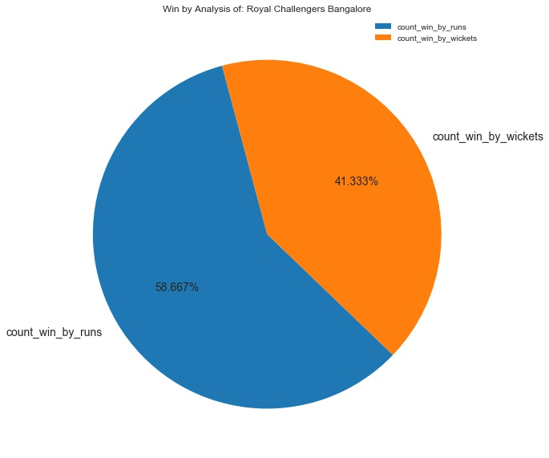
Royal Challengers Bangalore
Don’t challenge them while they bat!!!

Slide 21

SunRisers Hyderabad
They cover the field like the sunshine on a sunny day!!!

Slide 22


